Slide 1
Language Models
By Mohammad Rashidkhan
Prof. Jamshid Tashk

Slide 2
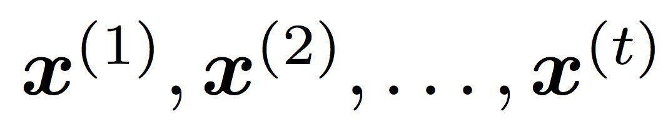
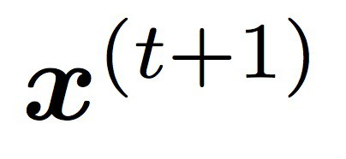
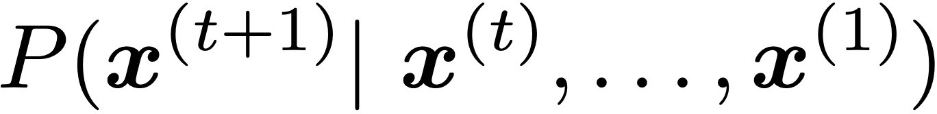

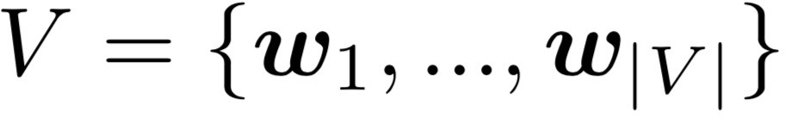
Language Modeling
Language Modeling is the task of predicting what word comes next
books
the students opened their
laptops
exams
minds
More formally: given a sequence of words
compute the probability distribution of the next word
,
:
where can be any word in the vocabulary
A system that does this is called a Language Model

Slide 3
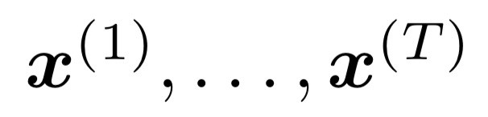
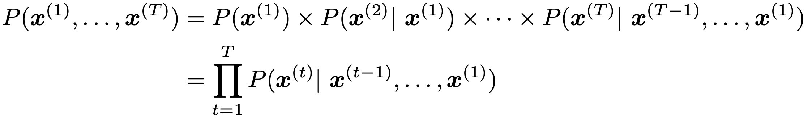
Language Modeling
You can also think of a Language Model as a system that assigns a probability to a piece of text
For example, if we have some text , then the probability of this text (according to the Language Model) is:
This is what our LM provides

Slide 4
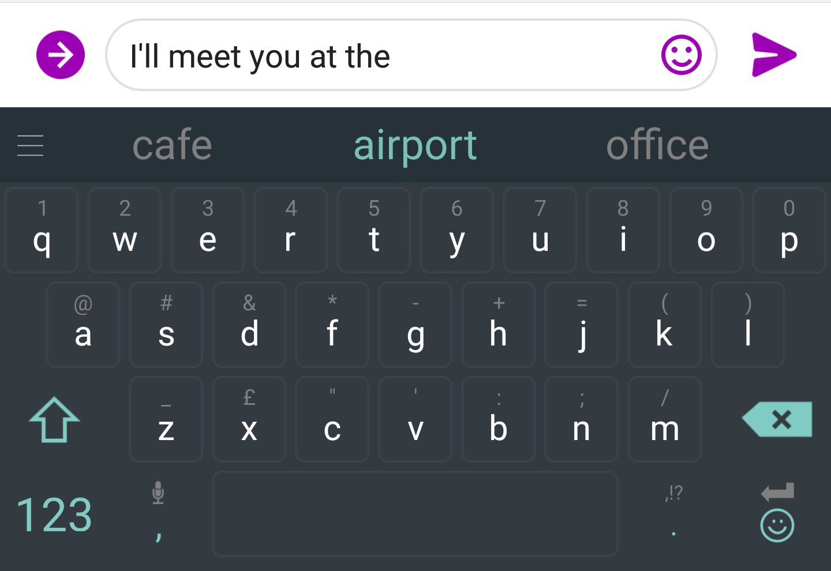
You use Language Models every day!

Slide 5

You use Language Models every day!

Slide 6
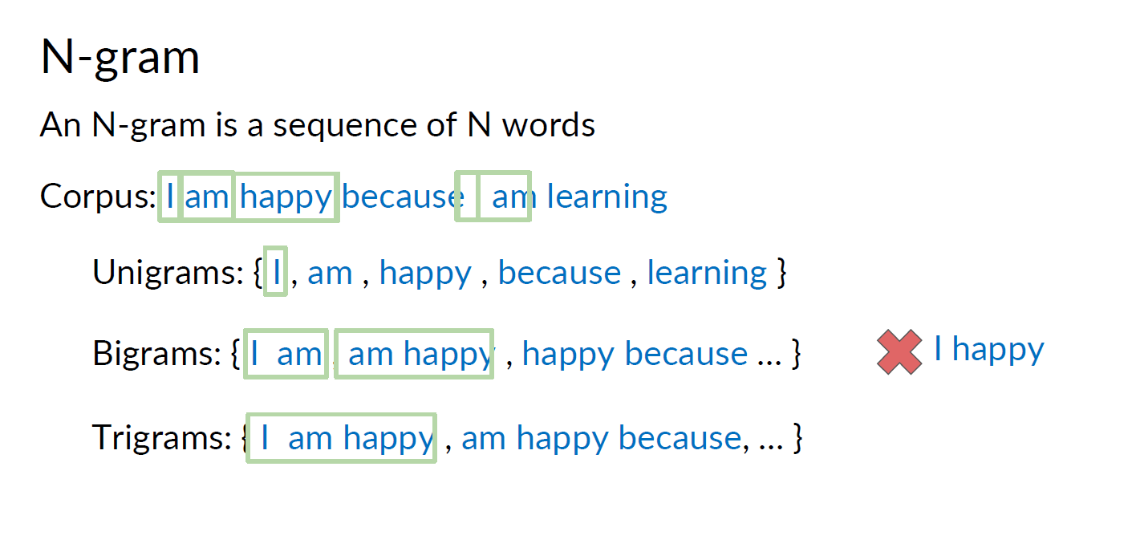
n-gram Language Models

Slide 7
n-gram Language Models
the students opened their
Question: How to learn a Language Model?
Answer (pre- Deep Learning): learn an n-gram Language Model!
Definition: An n-gram is a chunk of n consecutive words.
unigrams: “the”, “students”, “opened”, ”their”
bigrams: “the students”, “students opened”, “opened their”
trigrams: “the students opened”, “students opened their”
four-grams: “the students opened their”
Idea: Collect statistics about how frequent different n-grams are and use these to predict next word.

Slide 8
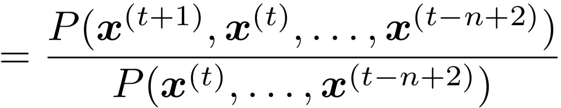
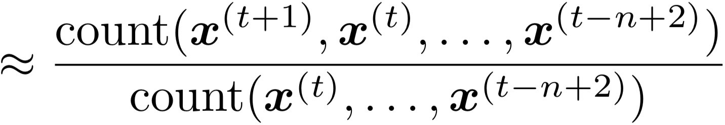
n-gram Language Models
First we make a Markov assumption: 𝑥^{(t+1)} depends only on the preceding n-1 words
n-1 words
(assumption)
prob of a n-gram
(definition of conditional prob)
prob of a (n-1)-gram
Question: How do we get these n-gram and (n-1)-gram probabilities?
Answer: By counting them in some large corpus of text!
(statistical approximation)

Slide 9
n-gram Language Models: Example
Suppose we are learning a 4-gram Language Model.
as the proctor started the clock, the
students opened their
condition on this
discard
For example, suppose that in the corpus:
“students opened their” occurred 1000 times
“students opened their books” occurred 400 times
→ P(books | students opened their) = 0.4
“students opened their exams” occurred 100 times
→ P(exams | students opened their) = 0.1
Should we have discarded the “proctor” context?

Slide 10
Sparsity Problems with n-gram Language Models
Sparsity Problem 1
Problem: What if “students opened their 𝑤” never occurred in data? Then 𝑤 has probability 0!
(Partial) Solution: Add small 𝛿 to the count for every 𝑤 ∈ 𝑉. This is called smoothing.
Sparsity Problem 2
Problem: What if “students opened their” never occurred in data? Then we can’t calculate probability for any 𝑤!
(Partial) Solution: Just condition on “opened their” instead.
This is called backoff.
Note: Increasing n makes sparsity problems worse.
Typically, we can’t have n bigger than 5.

Slide 11
Storage Problems with n-gram Language Models
Storage: Need to store count for all n-grams you saw in the corpus.
Increasing n or increasing corpus increases model size!

Slide 12
n-gram Language Models in practice
You can build a simple trigram Language Model over a
1.7 million word corpus (Reuters) in a few seconds on your laptop*
Business and financial news
today the | get probability distribution
company | 0.153
bank | 0.153
price | 0.077
italian | 0.039
emirate | 0.039 …
Sparsity problem: not much granularity in the probability distribution
Otherwise, seems reasonable!
* Try for yourself: https://nlpforhackers.io/language-models/

Slide 13
Generating text with a n-gram Language Model
You can also use a Language Model to generate text
today the
condition on this
get probability distribution
company | 0.153
bank | 0.153
price | 0.077
italian | 0.039
emirate | 0.039 …
sample

Slide 14
Generating text with a n-gram Language Model
You can also use a Language Model to generate text
today the price
condition on this
get probability distribution
of | 0.308 | sample
for | 0.050
it | 0.046
to | 0.046
is | 0.031 …

Slide 15
Generating text with a n-gram Language Model
You can also use a Language Model to generate text
today the price of
condition on this
get probability distribution
the 18
oil
its gold
0.072
0.043
0.043
0.036
0.018
…
sample

Slide 16
Generating text with a n-gram Language Model
You can also use a Language Model to generate text
today the price of gold per ton , while production of shoe lasts and shoe industry , the bank intervened just after it considered and rejected an imf demand to rebuild depleted european stocks , sept 30 end primary 76 cts a share .
Surprisingly grammatical!
…but incoherent. We need to consider more than three words at a time if we want to model language well.
But increasing n worsens sparsity problem, and increases model size…

Slide 17
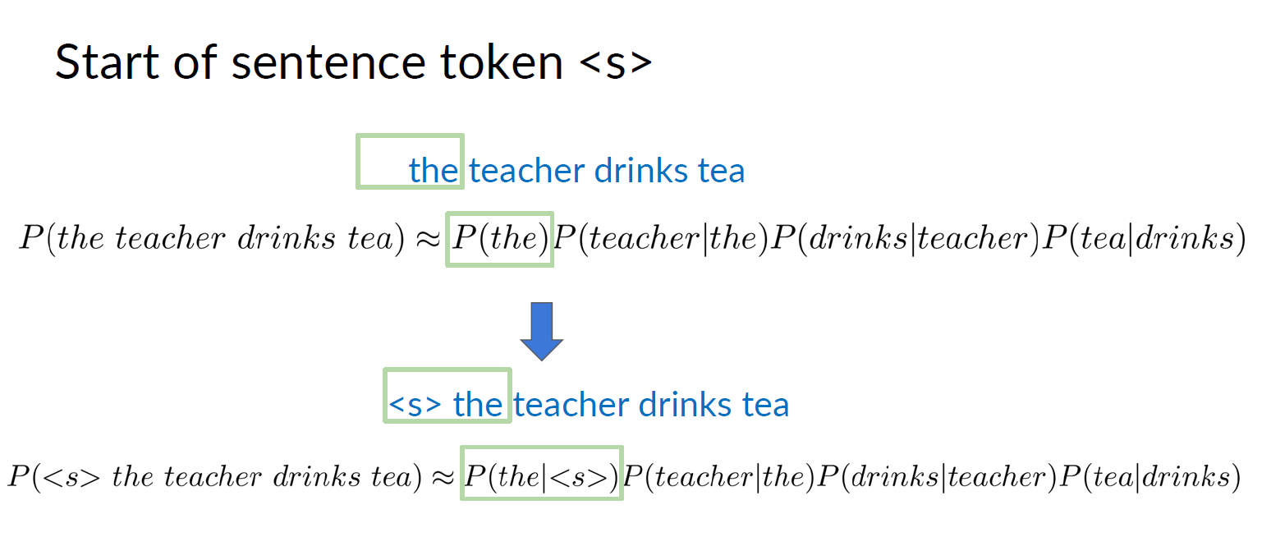

Slide 18
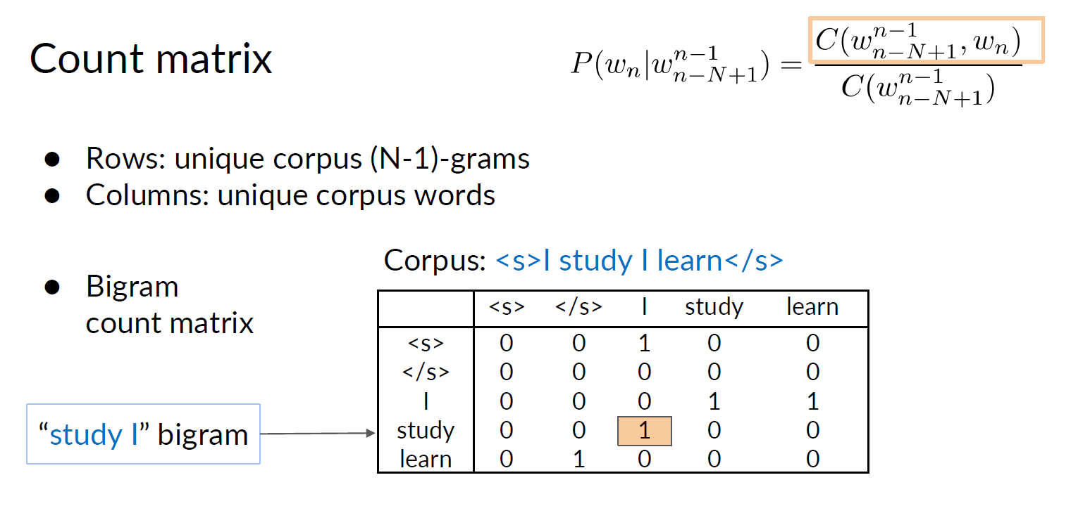

Slide 19
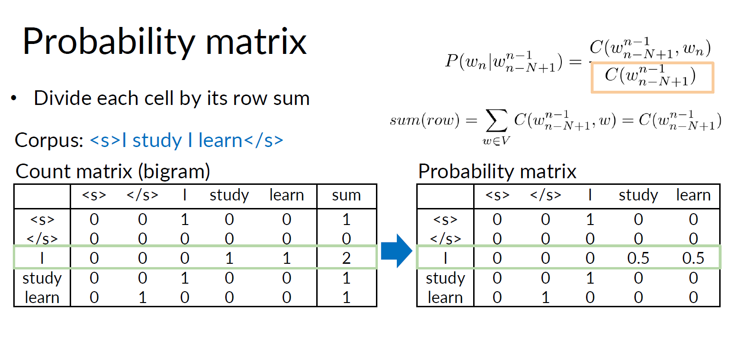

Slide 20
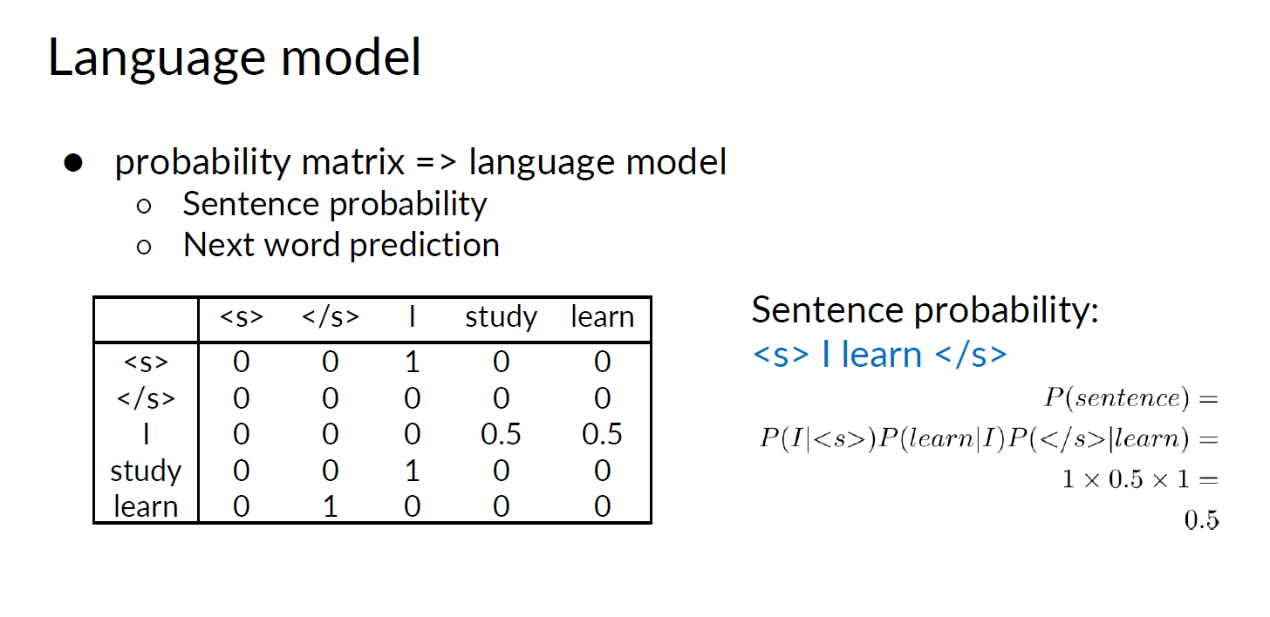

Slide 21
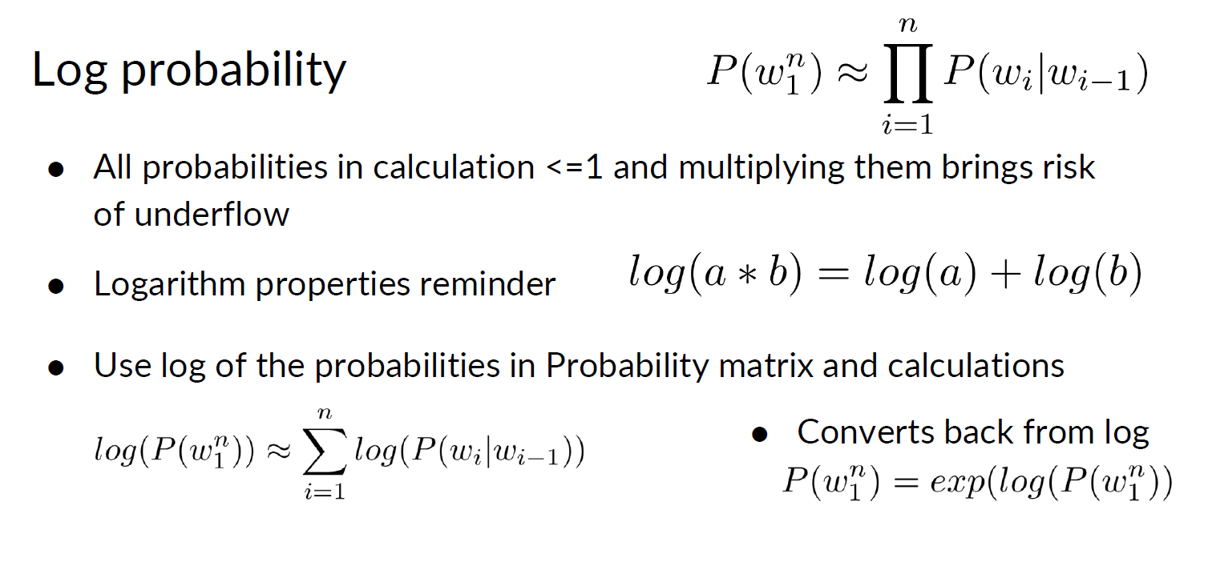

Slide 22
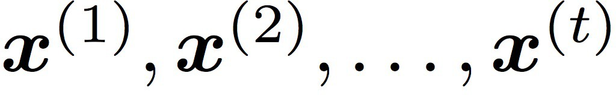

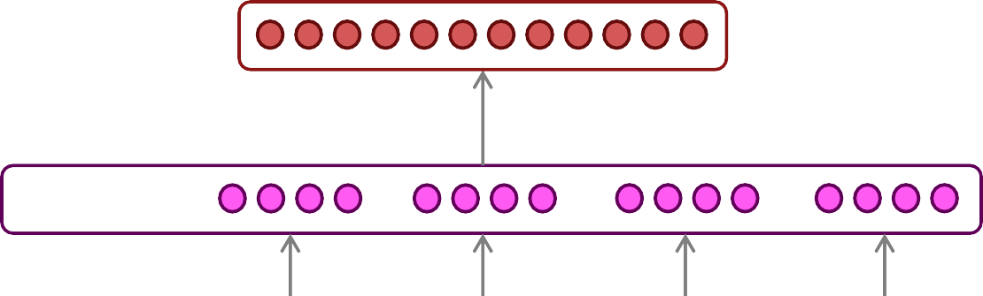




How to build a neural Language Model?
Recall the Language Modeling task:
Input: sequence of words
Output: prob dist of the next word
How about a window-based neural model?
We saw this applied to Named Entity Recognition in Lecture 3:
LOCATION
museums
in
Paris
are amazing

Slide 23
A fixed-window neural Language Model
as the proctor started the clock
the students opened
fixed window
their
discard

Slide 24


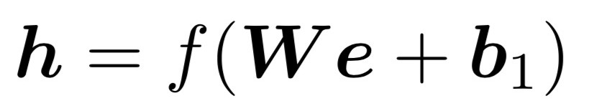




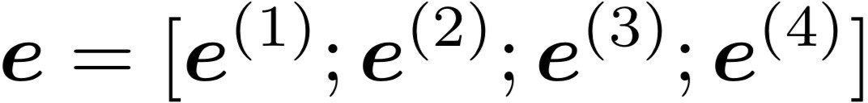


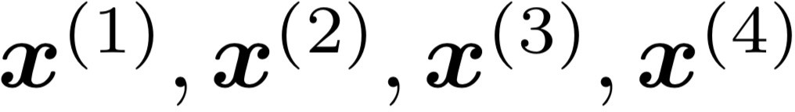
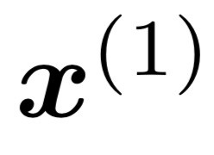
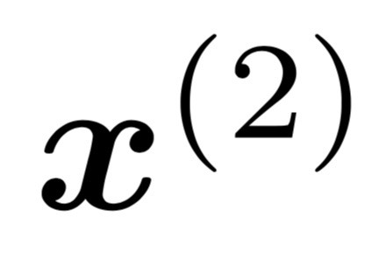
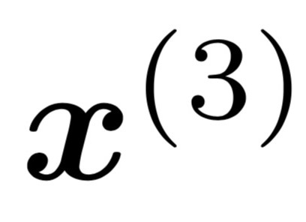
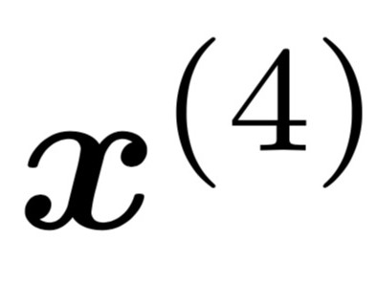
A fixed-window neural Language Model
books
laptops
output distribution
a
zoo
hidden layer
concatenated word embeddings
words / one-hot vectors
the students
opened
their

Slide 25




A fixed-window neural Language Model
Approximately: Y. Bengio, et al. (2000/2003): A Neural Probabilistic Language Model
Improvements over n-gram LM:
No sparsity problem
Don’t need to store all observed n-grams
books
laptops
a
zoo
Remaining problems:
Fixed window is too small
Enlarging window enlarges 𝑊
Window can never be large enough!
𝑥⁽⁰⁾ and 𝑥⁽¹⁾ are multiplied by completely different weights in 𝑊. No symmetry in how the inputs are processed.
We need a neural architecture that can process any length input
the students
opened
their

Slide 26
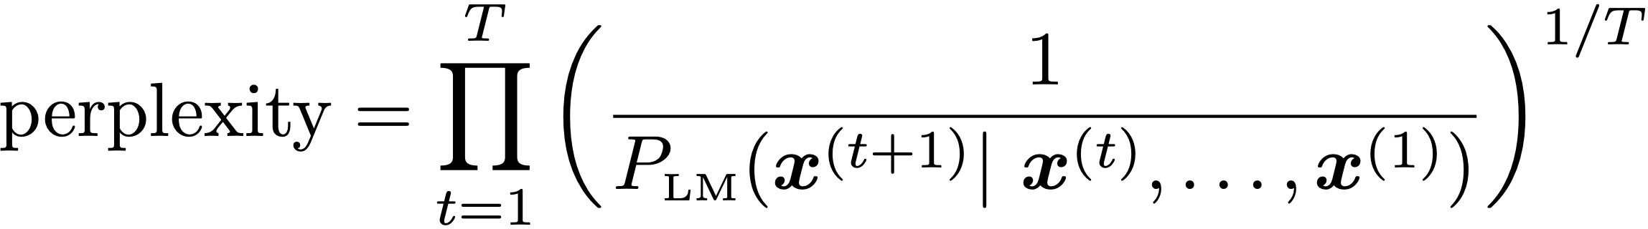
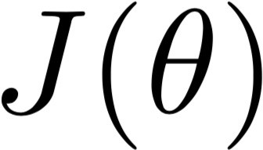
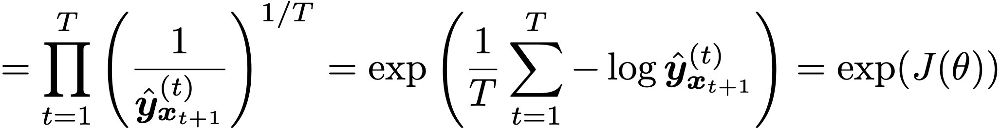
Evaluating Language Models
The standard evaluation metric for Language Models is perplexity.
Normalized by number of words
Inverse probability of corpus, according to Language Model
This is equal to the exponential of the cross-entropy loss
:
Lower perplexity is better!

Slide 27
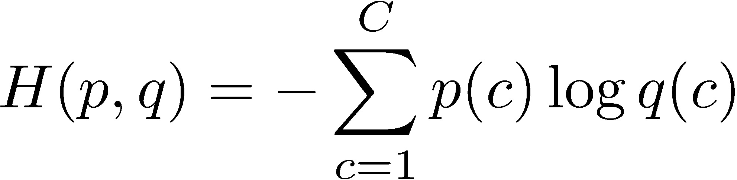
Cross Entropy Loss
Concept of “cross entropy” is from information theory
Let the true probability distribution be p
Let our computed model probability be q
The cross entropy is:
Assuming a ground truth (or true or gold or target) probability distribution that is 1 at the right class and 0 everywhere else:
p = [0,…,0,1,0,…0] then:
Because of one-hot p, the only term left is the negative log probability of the true class: − log 𝑝(𝑦>|𝑥>)
44

Slide 28
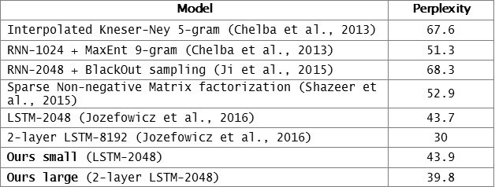
RNNs have greatly improved perplexity
n-gram model
Increasingly complex RNNs
Perplexity improves (lower is better)
Source: https://research.fb.com/building-an-efficient-neural-language-model-over-a-billion-words/

Slide 29
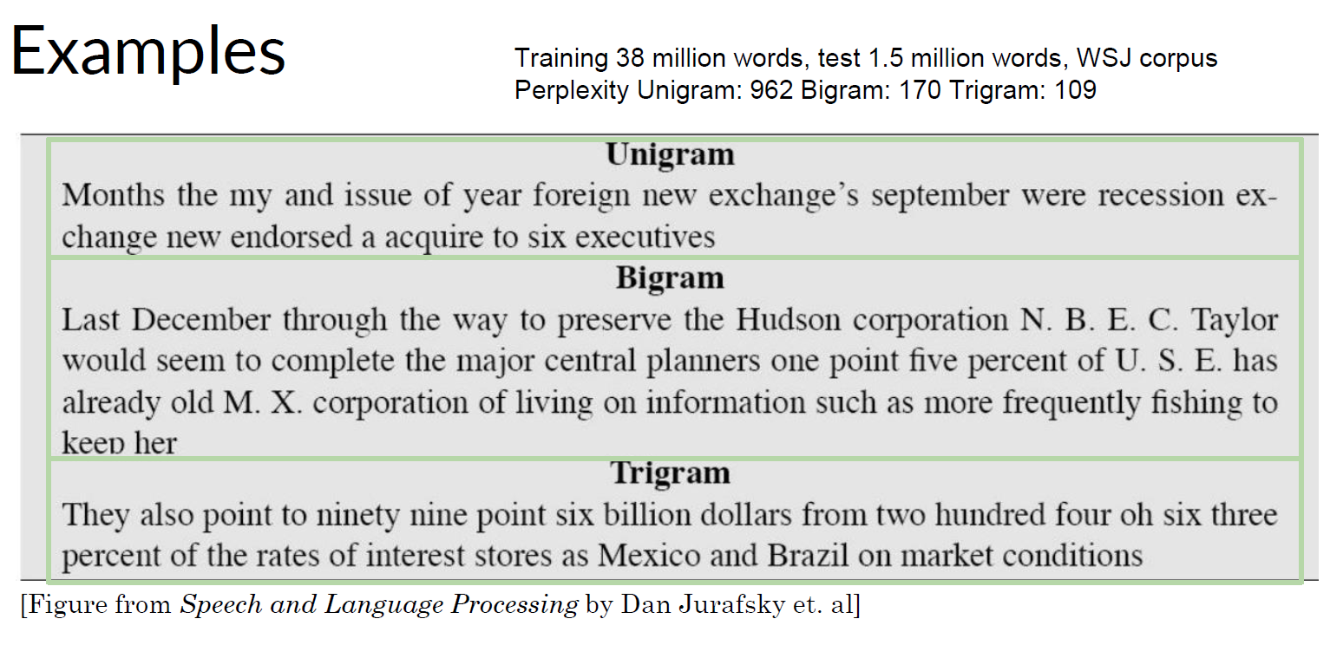

Slide 30
Why should we care about Language Modeling?
Language Modeling is a benchmark task that helps us measure our progress on understanding language
Language Modeling is a subcomponent of many NLP tasks, especially those involving generating text or estimating the probability of text:
Predictive typing
Speech recognition
Handwriting recognition
Spelling/grammar correction
Authorship identification
Machine translation
Summarization
Dialogue
etc.
Language Modeling has been extended to cover everything else in NLP: GPT-3 is an LM!

